Slide 1
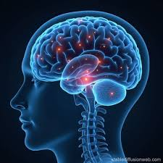
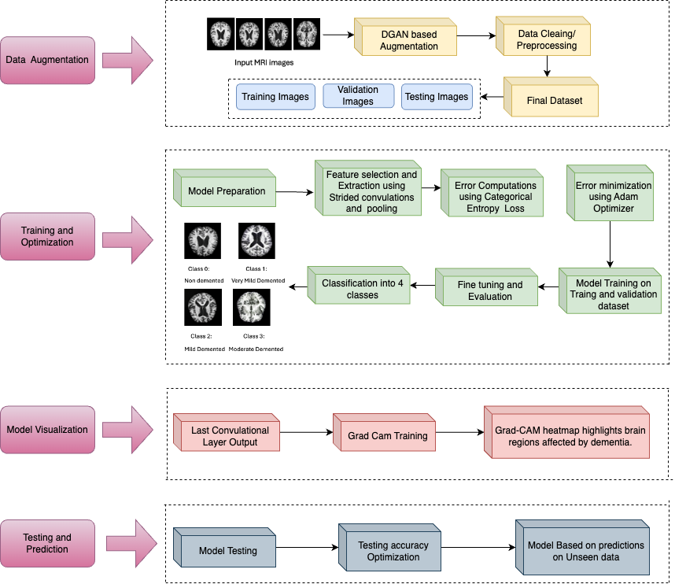
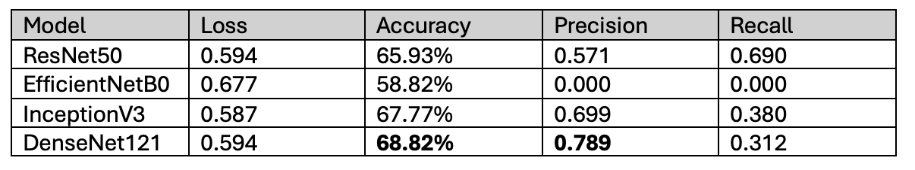
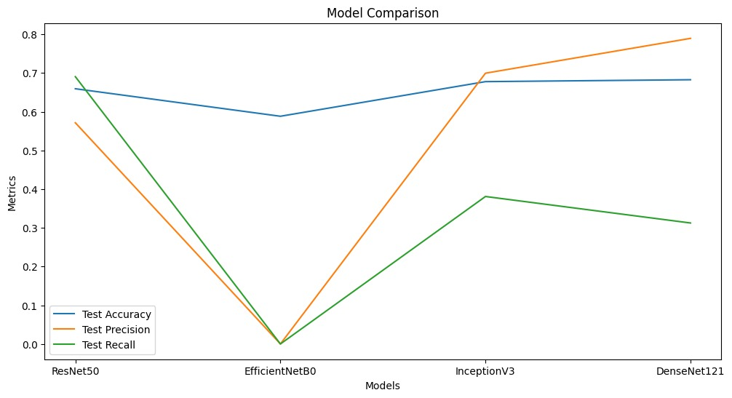
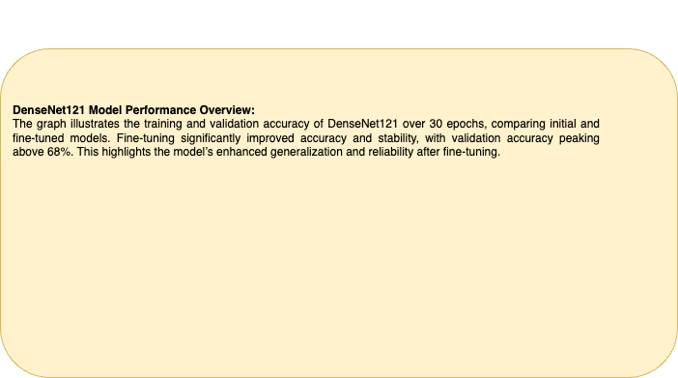
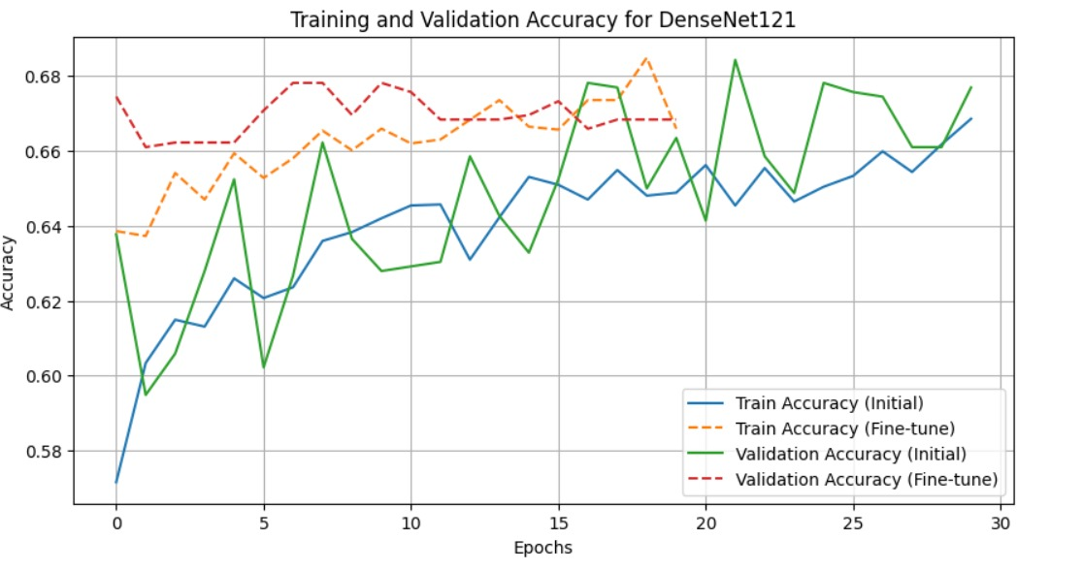
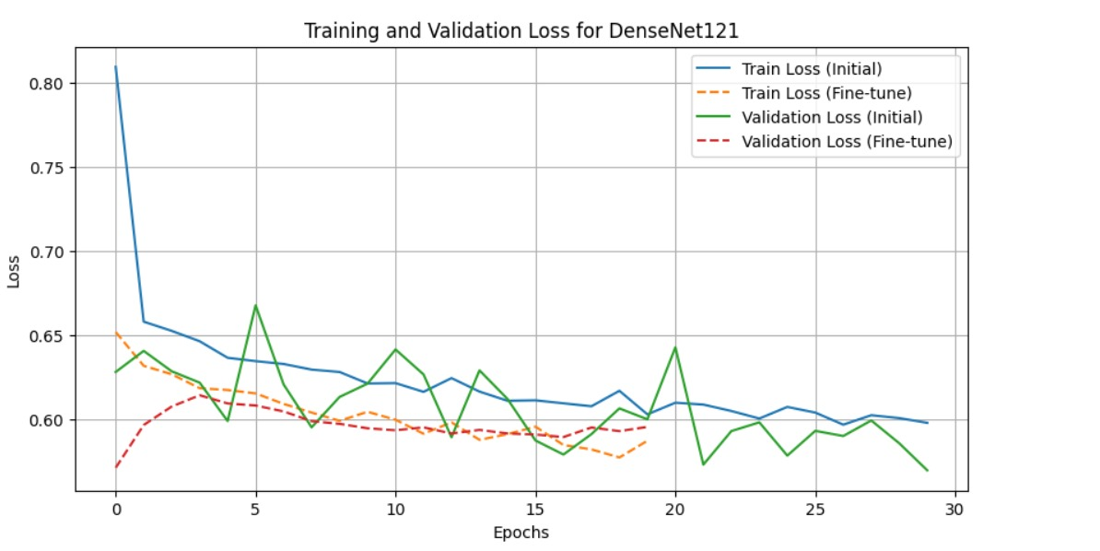
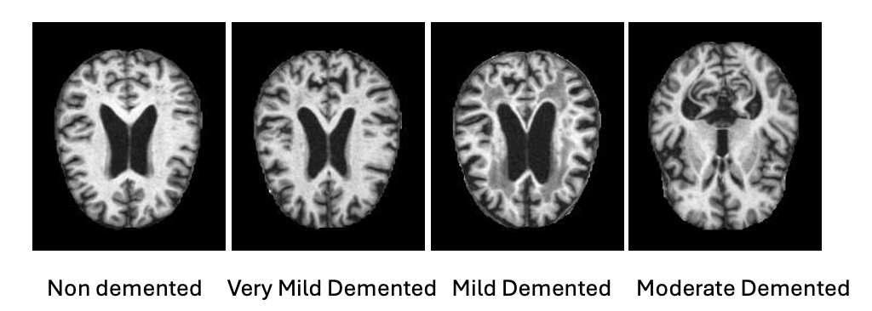
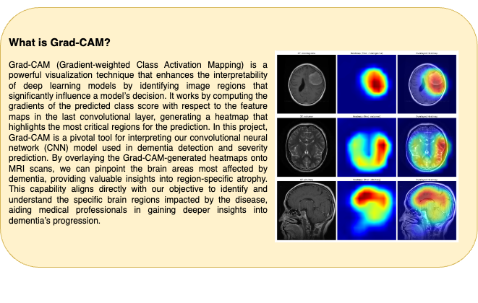
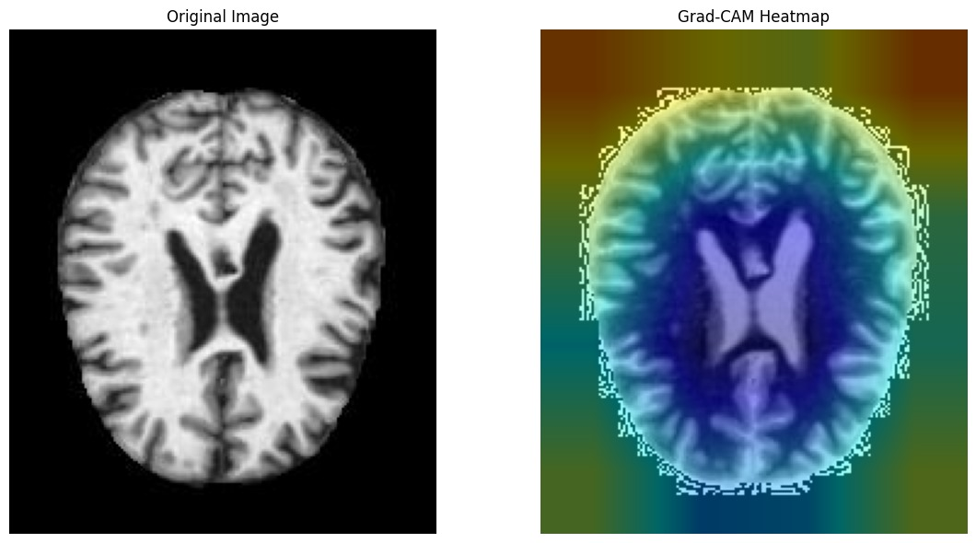
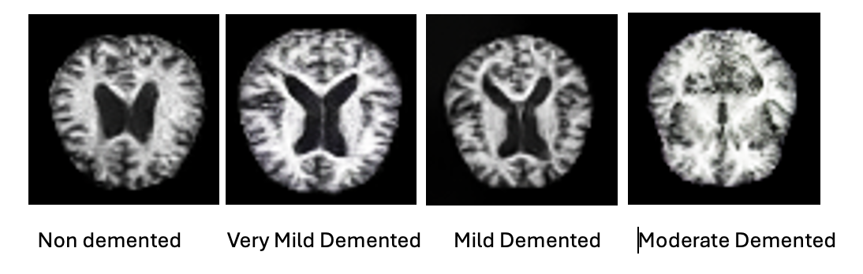
Deep Learning- Based Detection and Severity Prediction of Dementia Using MRI Scans with Region-Specific Analysis
Resham Bahira, Kulveen Kaur, Nithin Kumar, Sudhanshu Pawar
School of Information Studies, Syracuse University
Motivation
Methodology
Results
Dementia is a condition that affects the brain, causing problems with memory, thinking, and everyday activities. It includes diseases like Alzheimer’s and often begins with very mild stage, which can progress to more severe stages if not detected early. Millions of people around the world live with dementia, and the numbers are expected to grow.
Our project uses deep learning on MRI Scans with GradCAM to provide region-specific analysis, enhancing diagnostic accuracy, tracking disease progression, guiding therapies, and enabling early detection. By combining severity prediction with identification of the brain region contribution to the model’s prediction, this approach offers deeper insights and improved clinical outcomes.
.
Model Comparison Results for Dementia Classification
The Performance of four CNN models – ResNet50, EfficientNetBO, InceptionV3, and DenseNet121 was assessed. Based on the analysis of CNN models for dementia classification:
DenseNet121: Best performance with 68.26% accuracy and 0.778 AUC; high precision (78.95%) reduces false positives but low recall (31.25%) risks missing true cases.
InceptionV3: Balanced model with 67.77% accuracy, 0.752 AUC, and better precision-recall trade-off (69.95%/38.10%), ideal for sensitivity-specificity balance.
ResNet50: Moderate performance (65.93% accuracy, 0.731 AUC), trailing DenseNet121 and InceptionV3.
EfficientNetB0: Poor results (58.82% accuracy, 0.500 AUC), unable to differentiate classes effectively.
Affects millions, yet current methods lack precision in identifying brain regions impacted by the disease. While existing models detect dementia, they often overlook region-specific analysis, limiting personalized diagnosis and treatment. The motivation behind this project is to enhance diagnostic precision and enable targeted therapeutic strategies through advanced AI-driven analysis.
Dataset and Features
Source of Data: The dataset is sourced from Kaggle that includes original MRI images for dementia detection having 4 classes.
Original Dataset Size: Initially, the dataset contains 6,400 images categorized into four dementia severity classes: Mild Demented, Moderate Demented, Non-Demented, and Very Mild Demented.
Augmented Dataset Size: Augmentation via Deep Convolutional GAN (DCGAN) expanded the dataset to 10,000 images, with 2,500 images per class for better balance.
Features and Structure: The dataset consists of grayscale MRI images with pixel values, categorized by the severity of dementia.
Conclusion and Future Work
We achieved the highest accuracy (68.82%) and precision using DenseNet121, making it highly effective for diagnosing and predicting the severity of dementia
Using this model we generated the Grad-CAM heatmap that uses blue color to indicate areas of high importance, highlighting brain regions that significantly contribute to the model's predictions about dementia severity or progression.
Future Work
We can use other augmented techniques like StyleGAN to further improve the accuracy
We can also use multimodal technique to combine non-image data (Patient History) and image data (MRI Scans) for better predictions.
We can also expand our model and generalize it to predict other neurodegenerative diseases like Parkinson's or Huntington’s.

